Slide 1
Omni
Fun on a Bun

Slide 2
Morphology
Dendrites
Glial Cell
Axon
Mergers
Anatomical Clues
Synapses
Mitochondria
Vesicles
Bugs and problems
Slide Damage
Rendering Issues
Misc

Slide 3
Morphology
Shape can be great

Slide 4
Dendrites
Spines are fine

Slide 5
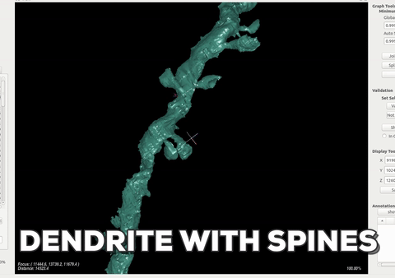

Slide 6
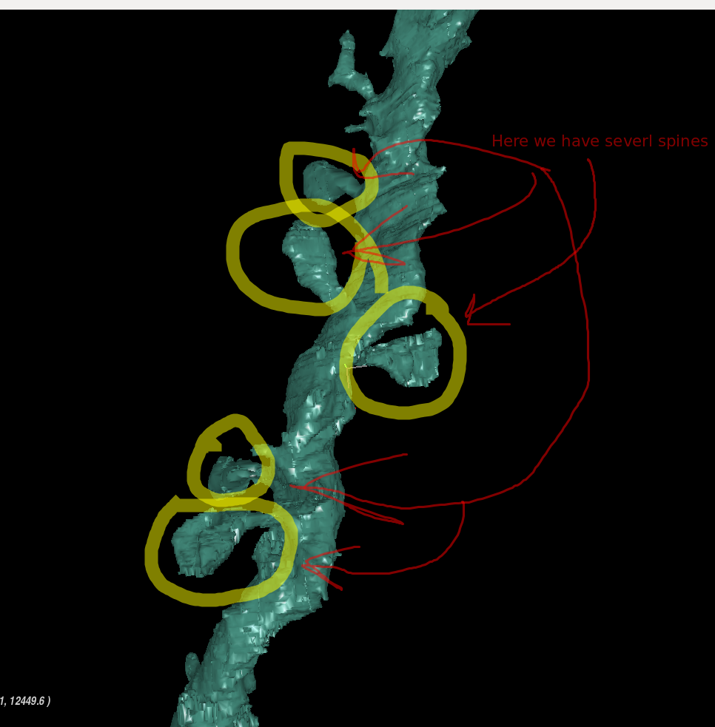
Here we have several spines

Slide 7
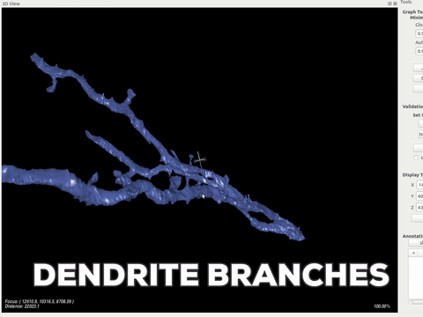

Slide 8
Dendrites are usually larger than axons and have many protrusions called spines
Spines almost always end in a synapse with an axon
There are cases where spines can end synapsing in other ways
Dendrites tend to branch out in acute angles

Slide 9
Glial Cell

Slide 10
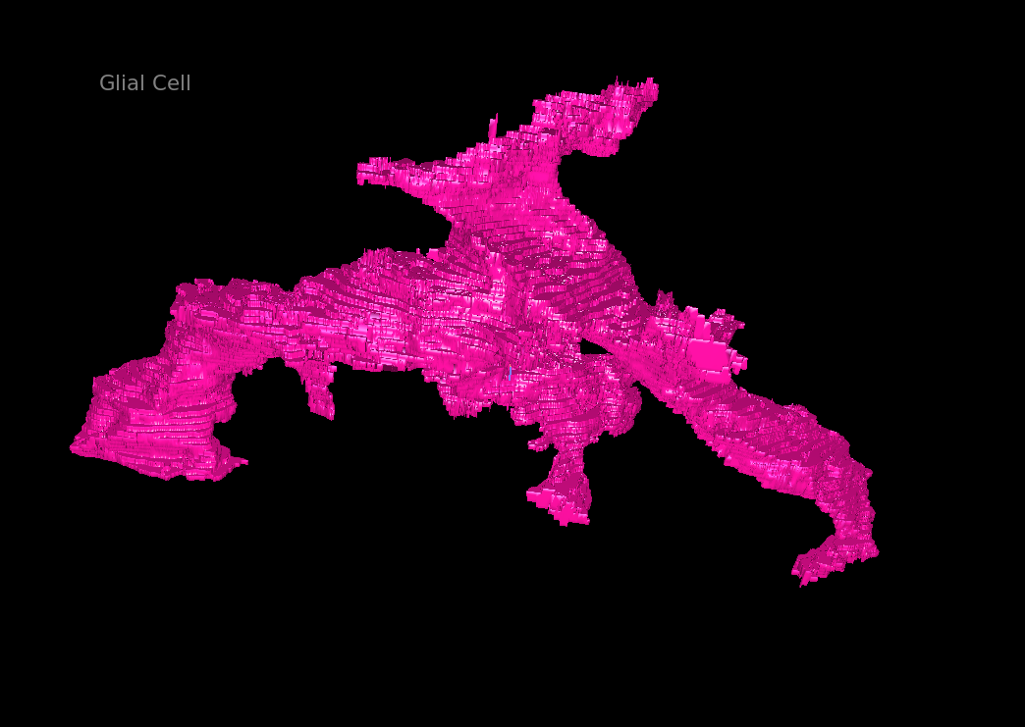
Glial Cell

Slide 11
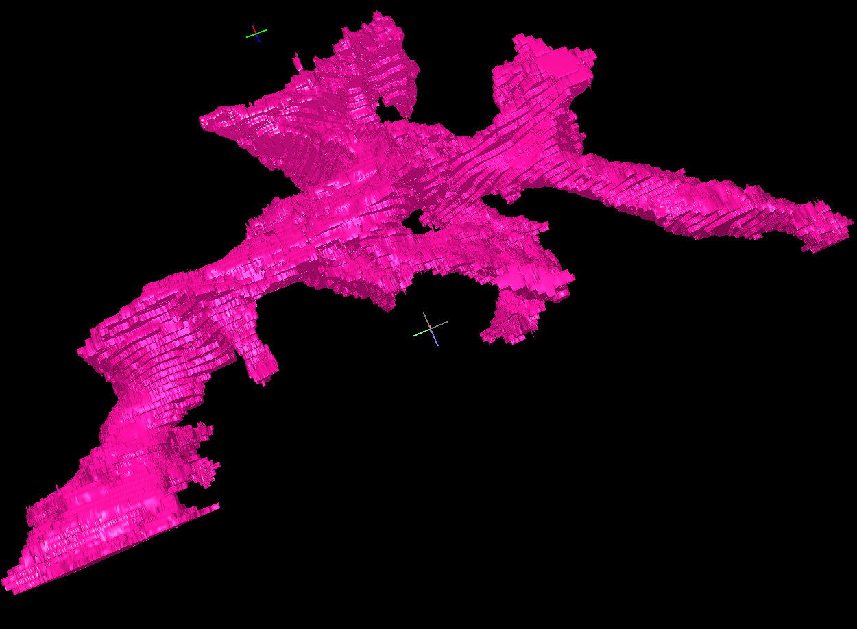
Glial Cell

Slide 12
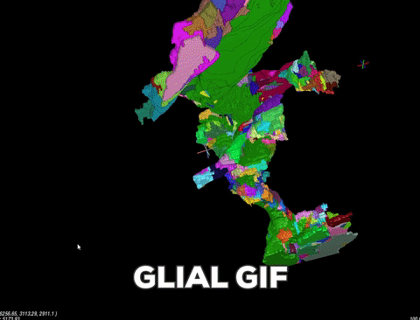

Slide 13
Glial cells act as a support to other cells
They can range in size shape and length, from very large to very slim, curvy and straight, lengthy and suddenly truncated
They curve and cup dendrites and axons expanding in all directions
We don’t trace Glia cells at this time
If you are doing a task with a glial cell just send it to the Uncertain Tab (referred to on the Left Hand Side Buttons list)

Slide 14
Axon
Axon axoff

Slide 15
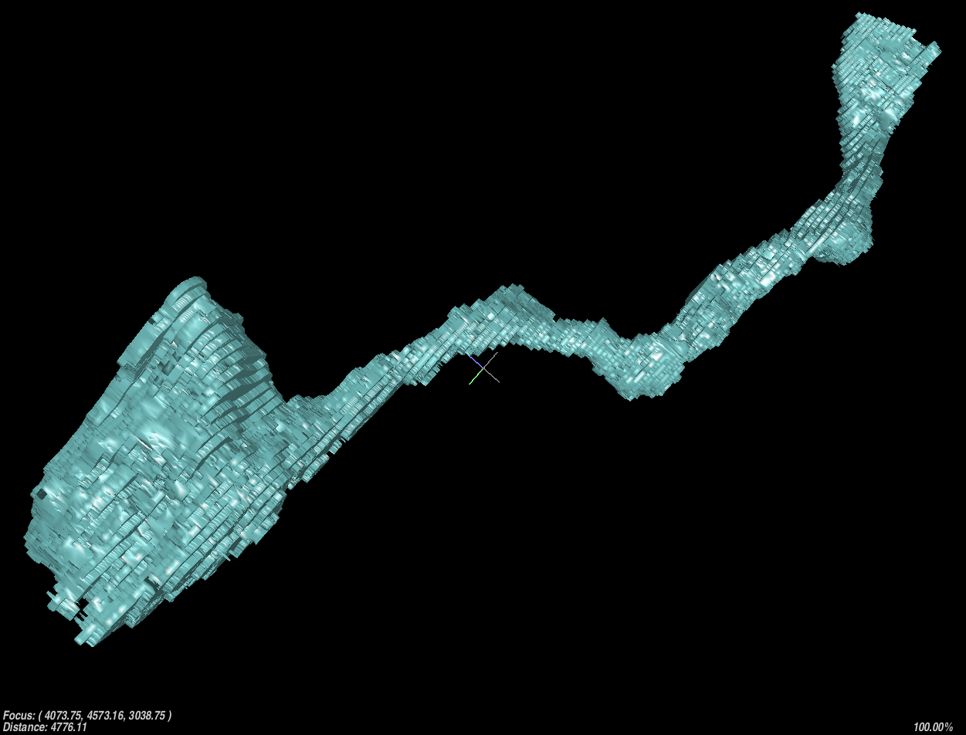
Axon

Slide 16
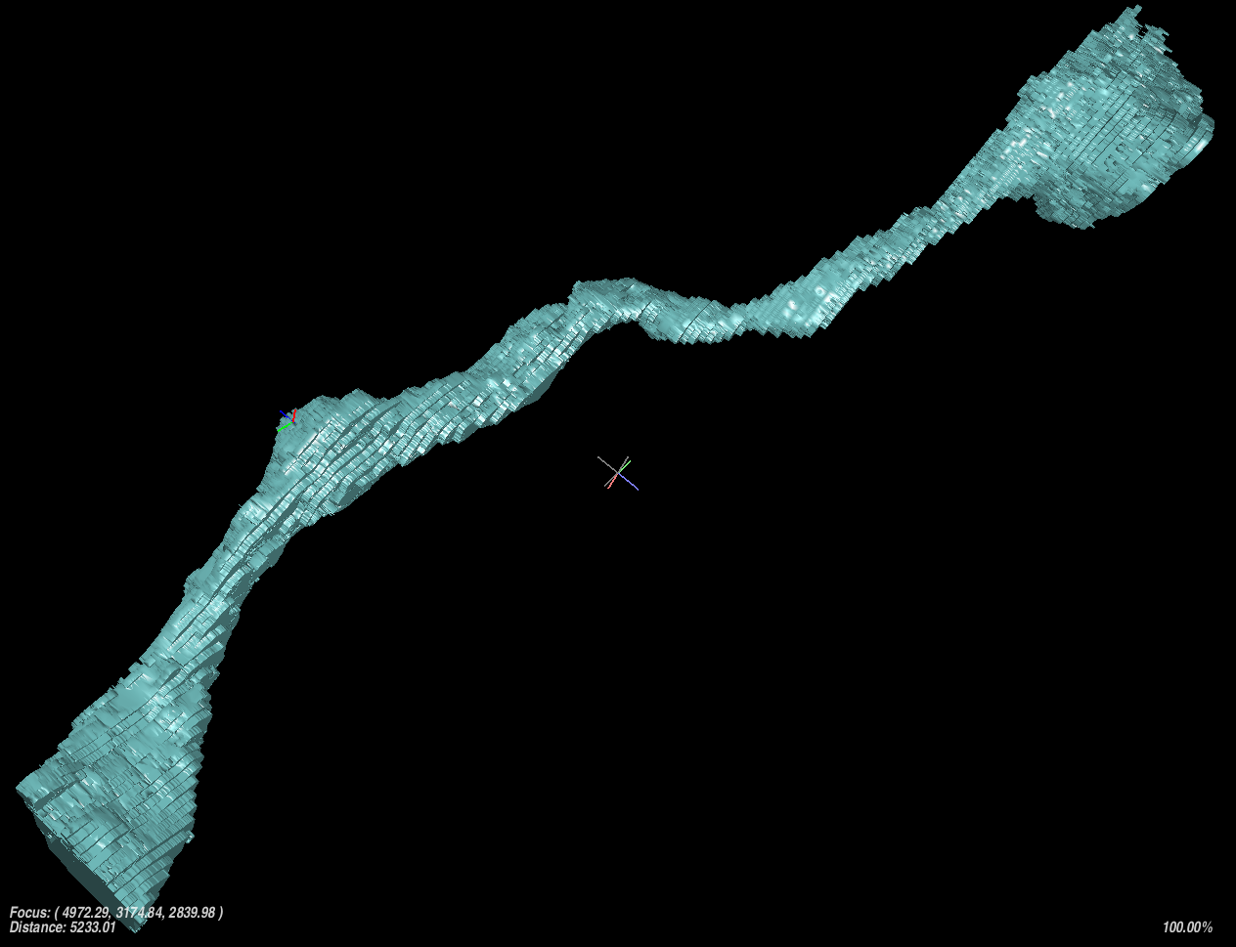
Axon

Slide 17
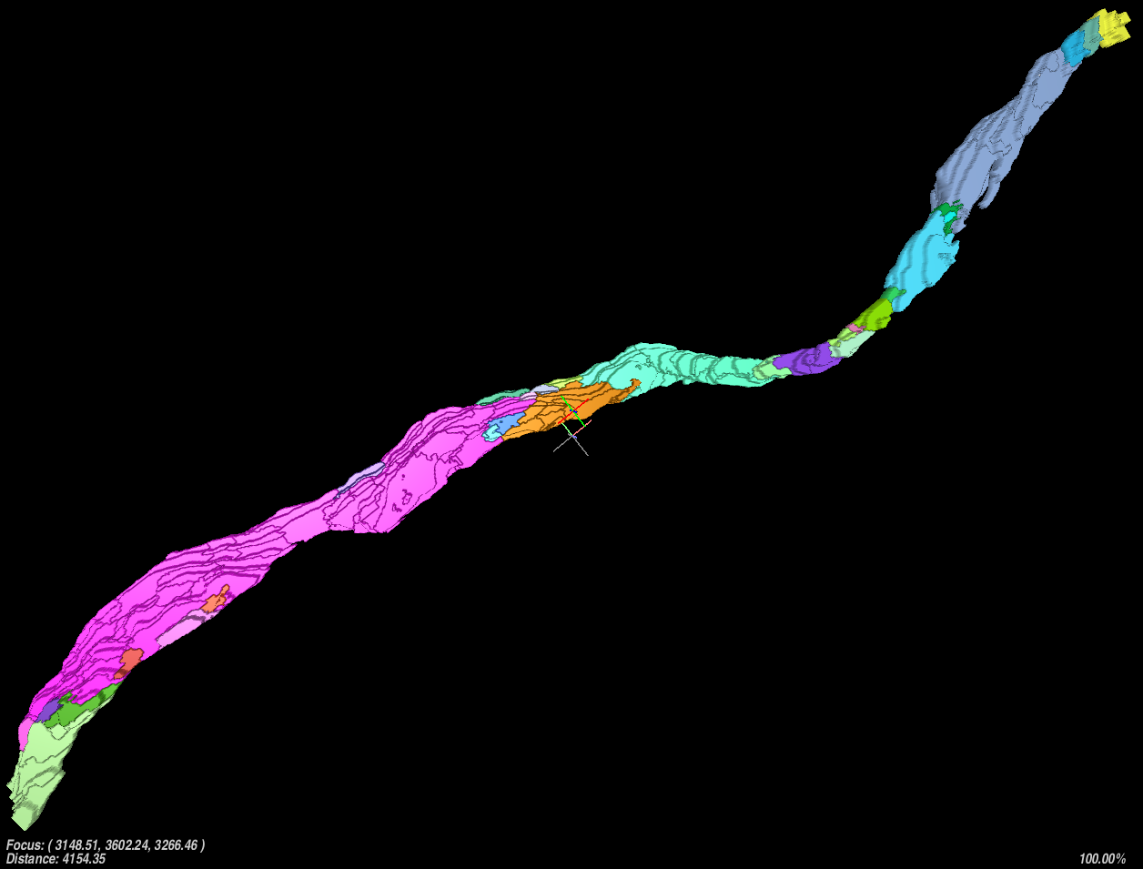
Axon

Slide 18
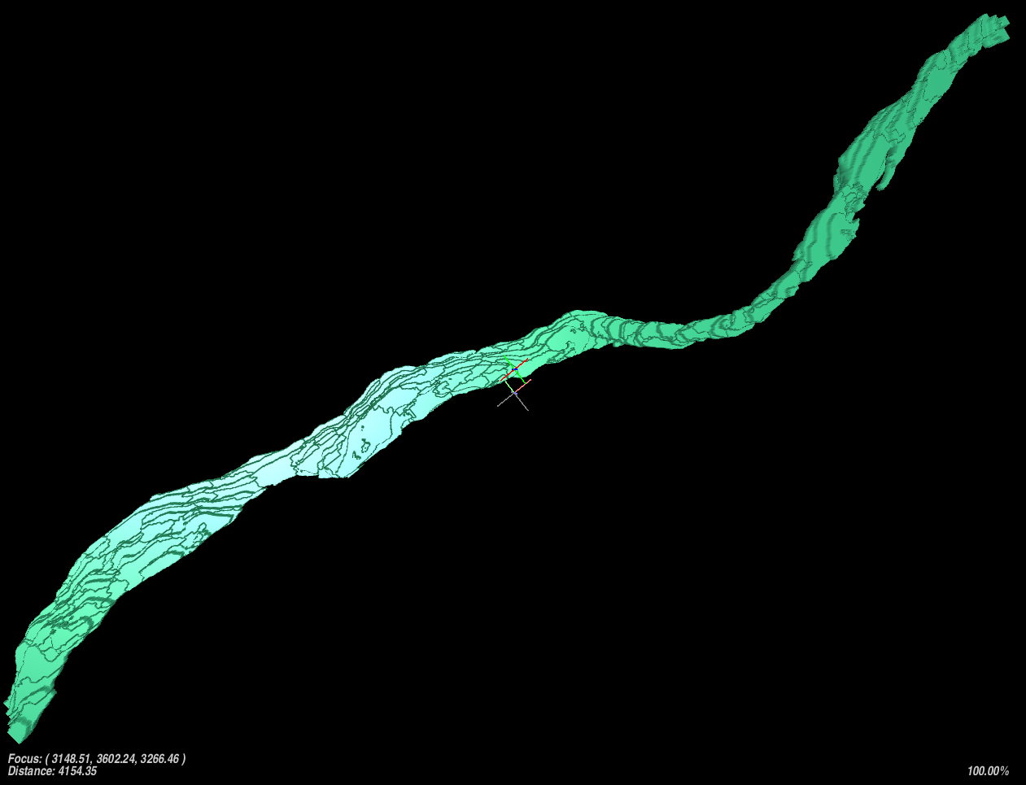
Axon

Slide 19
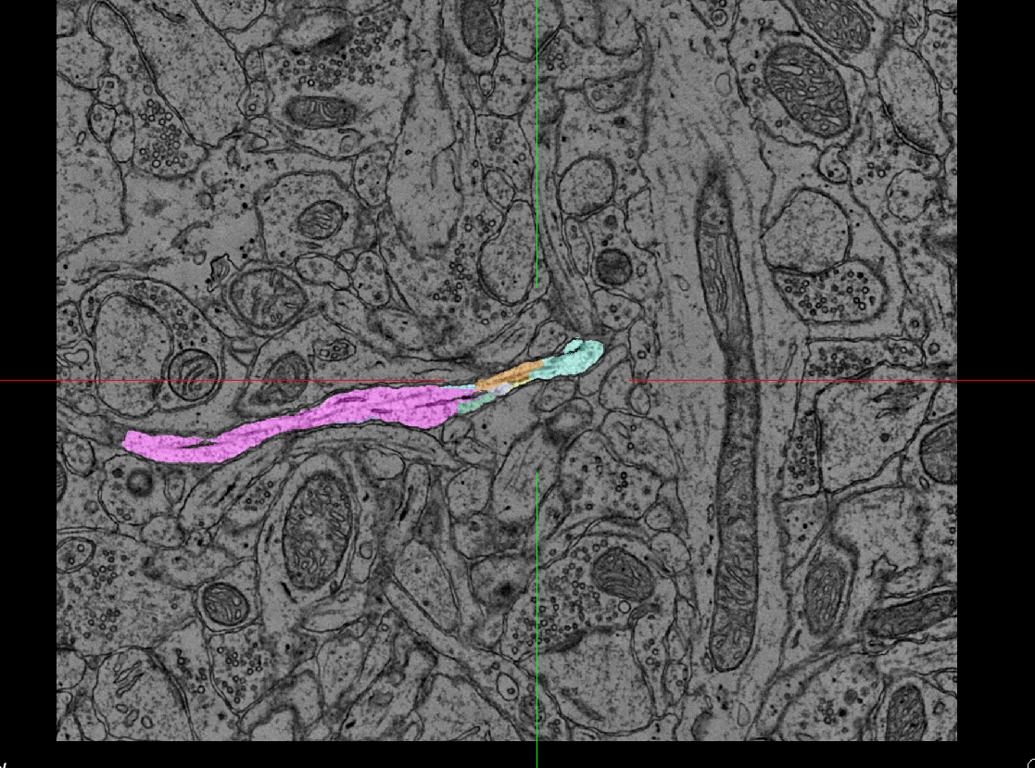
Axon
EM View
The way this axon crosses the image is called
"parallel to the sectioning plane" or just "parallel to the plane"

Slide 20
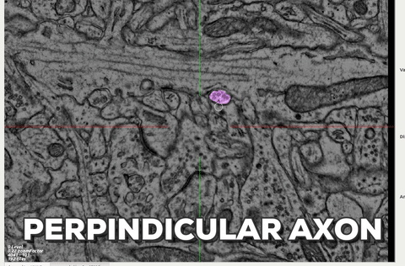

Slide 21
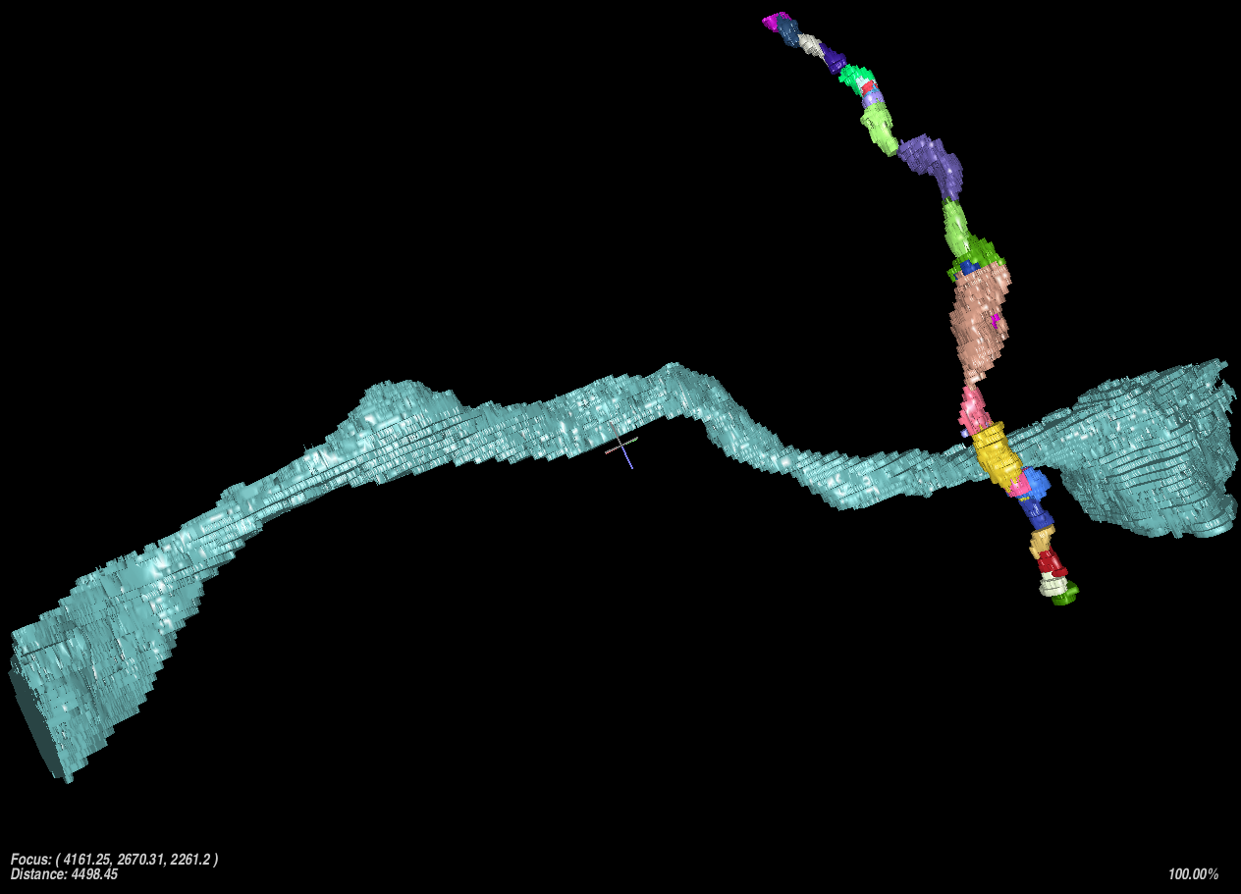
Perpendicular and parallel side by side

Slide 22
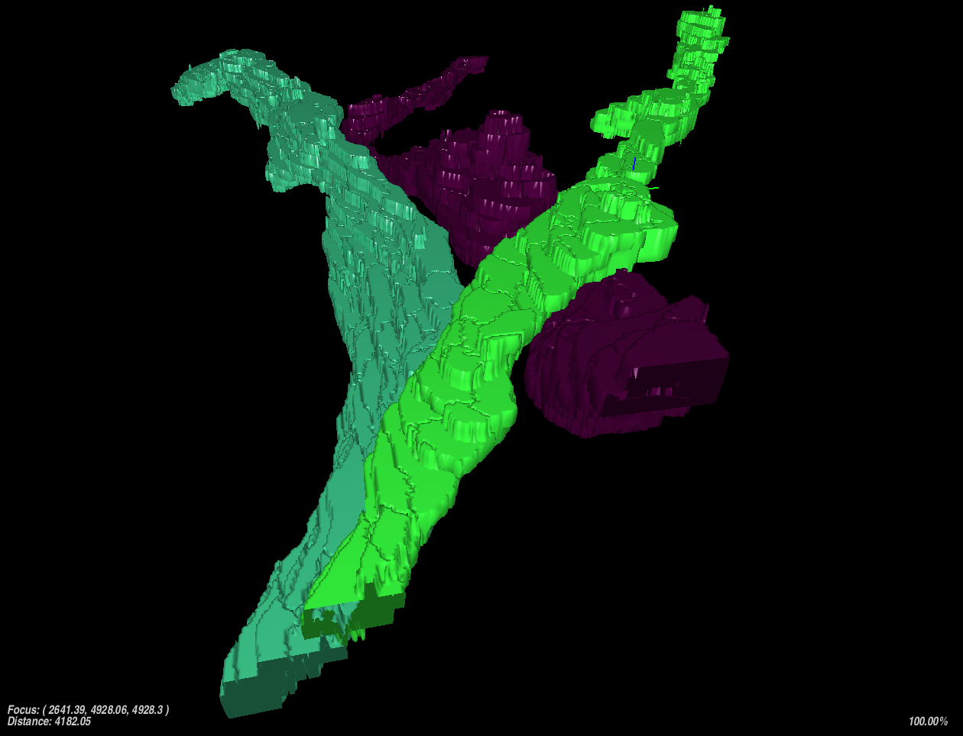
Axons going in the same direction

Slide 23
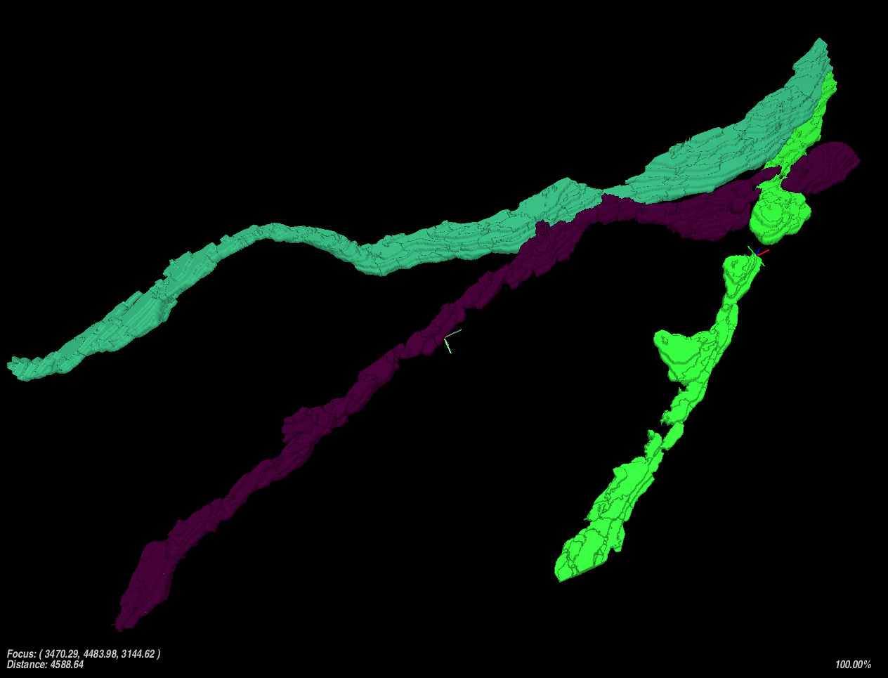
Axons going in the same direction

Slide 24
Axons almost always exit a volume (cube)
Axons can range in size from very thin to medium sized and even thicker than dendrites
Axons can have clusters of dense vesicles
Axons tend to flow together in groups going approximately the same direction
Axons tend to branch in obtuse angles

Slide 25

Mergers
Those who merger together get purged together

Slide 26
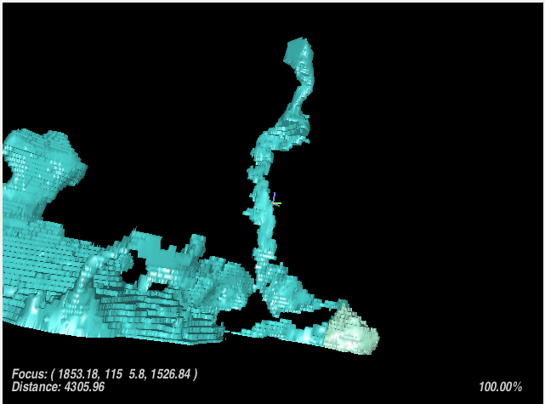
Here we observe a large merger between an axon and a spine of a dendrite

Slide 27
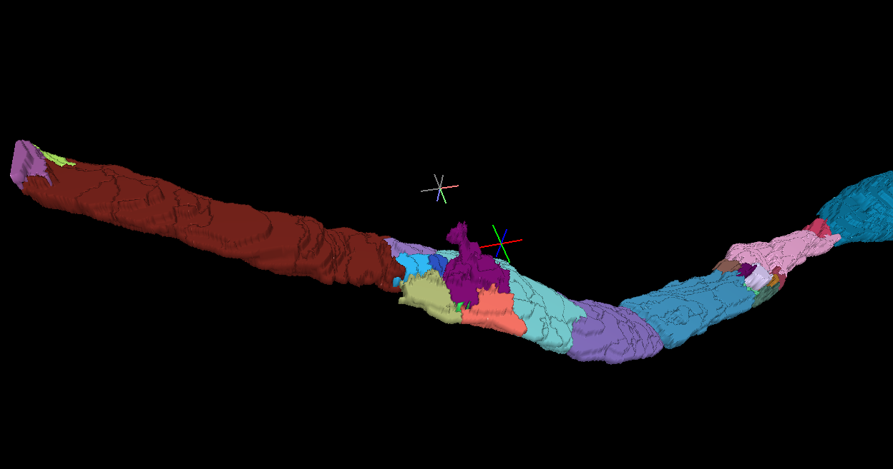
Here we have an AI merger spilling outside its boundaries a bit

Slide 28
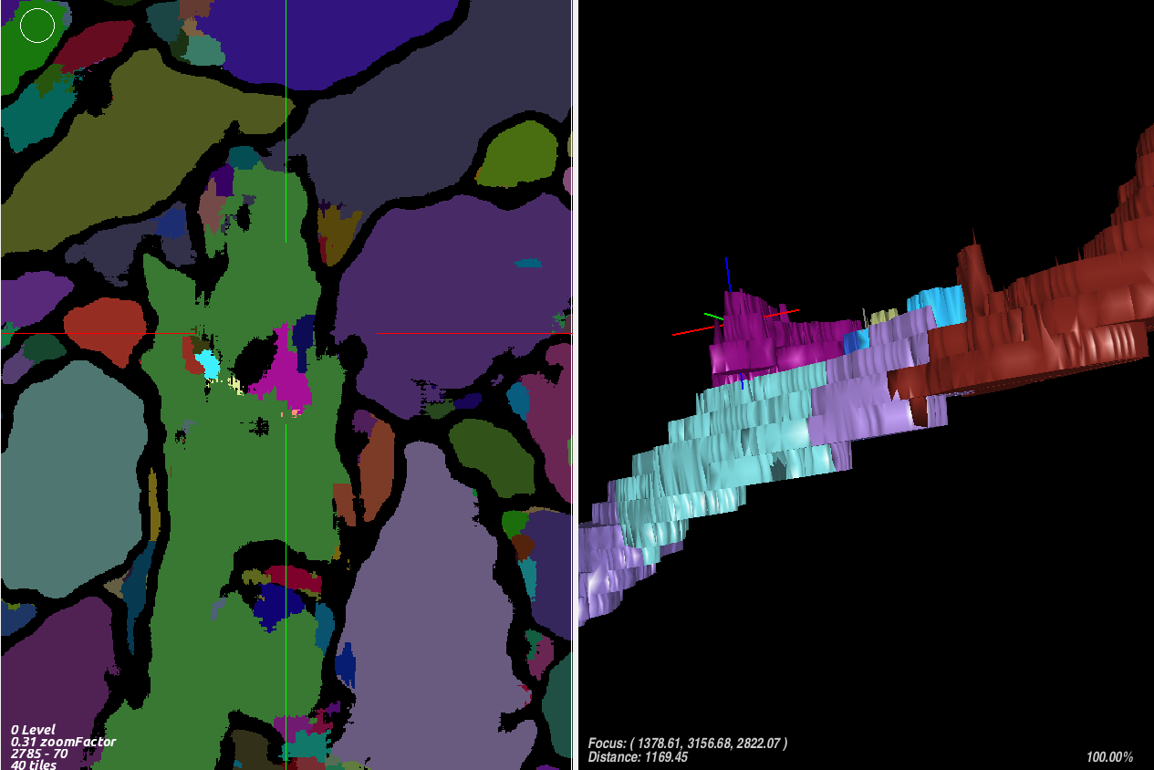
Segmentation1 View
Same AI Spill Merger

Slide 29
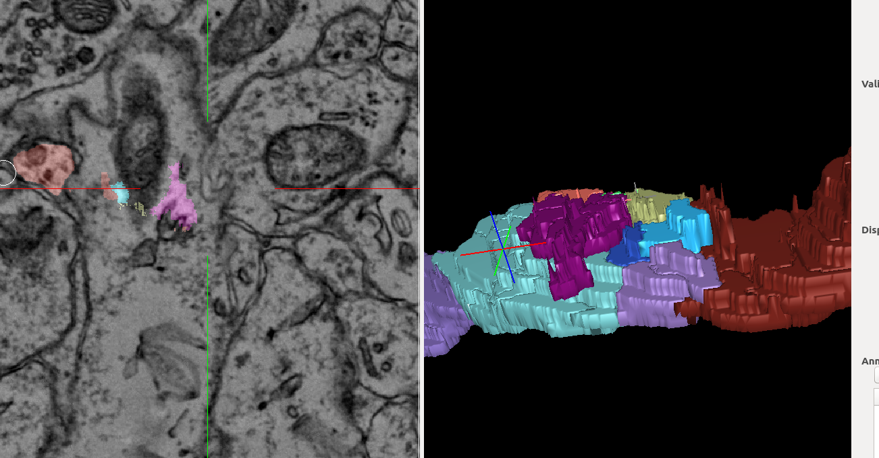
EM View
AI Spill Merger

Slide 30
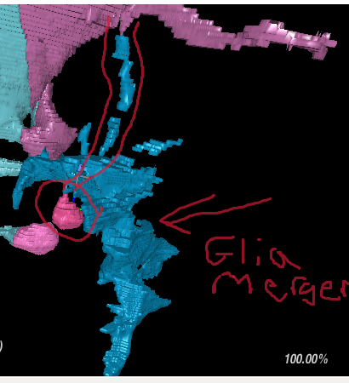
Here we have a long spine (circled in red) merged with a glial cell

Slide 31
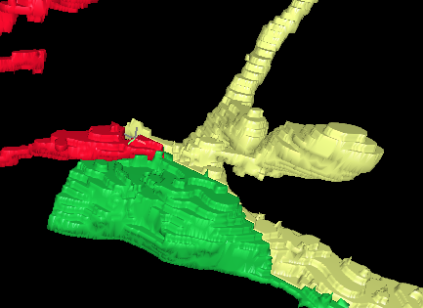
Here we have a yellow spine being cut off from its red stem

Slide 32
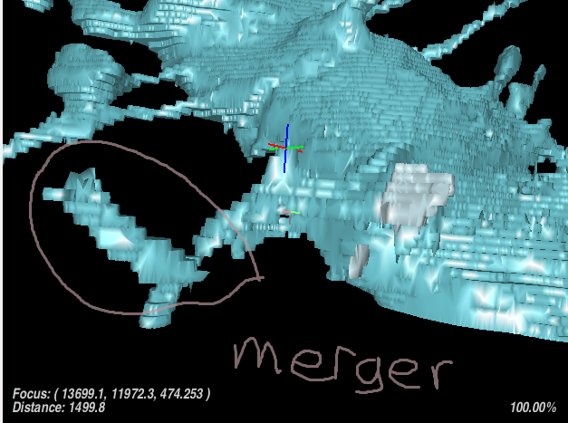
Here we have a small merger attached to the stem of the spine

Slide 33
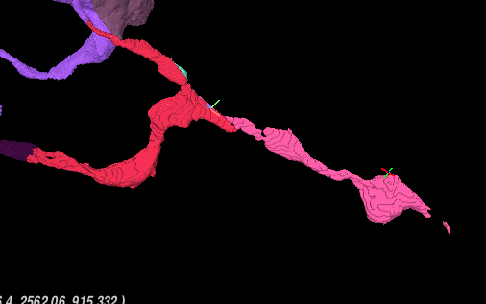
Here we have a red spine that should end at the rounded part

Slide 34
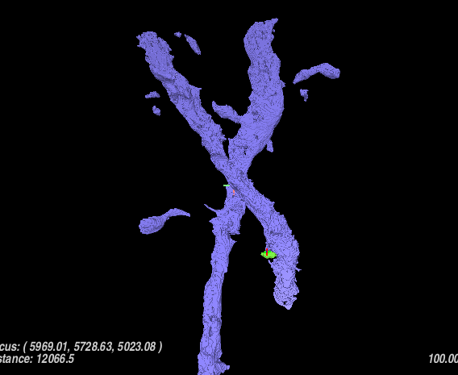
Two heavy duty dendrites merged together

Slide 35
Anatomical Clues
We got clues to use

Slide 36

Synapses
Synapse Crackle Pop

Slide 37
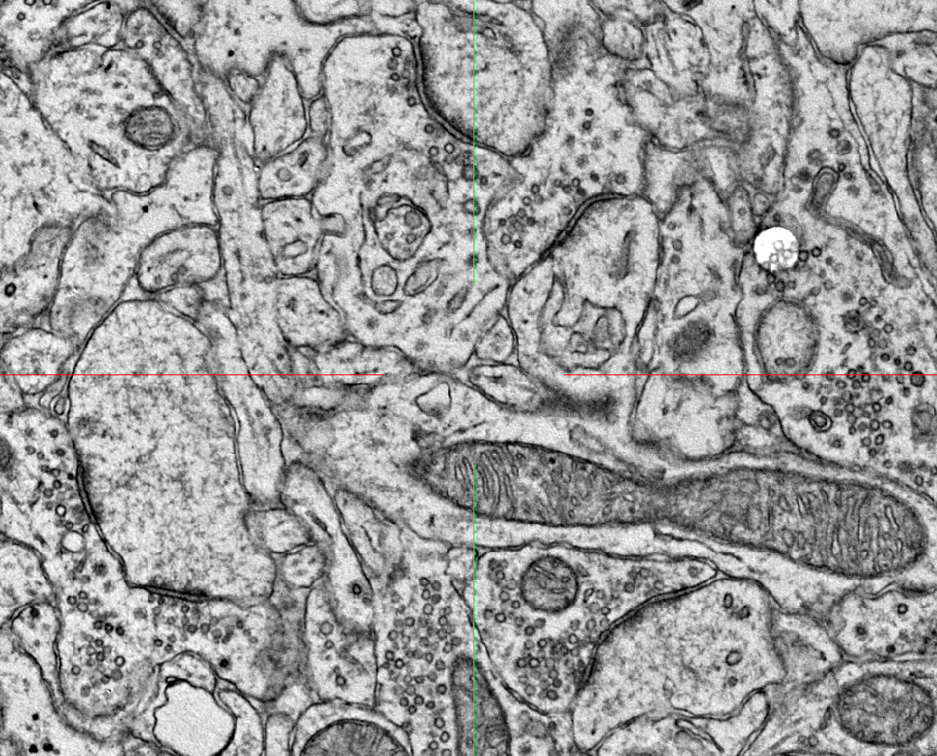
Here we have some classic synapses

Slide 38
We have a sneaky little mitochondria

Slide 39
The dark part is called the synaptic cleft

Slide 40
And tons of vesicles

Slide 41
What can we assume from this picture during a tracing of these synapses?

Slide 42
2
1
1
2
2
Bingo! It’s likely the (1s) are axons and (2s) are spines (dendrites)
1
1
2

Slide 43
2
1
1
2
2
(1s) AKA Presynaptic site and (2s) AKA Postsynaptic site
1
1
2

Slide 44

Mitochondria
Their powerlevel is over 9000!

Slide 45
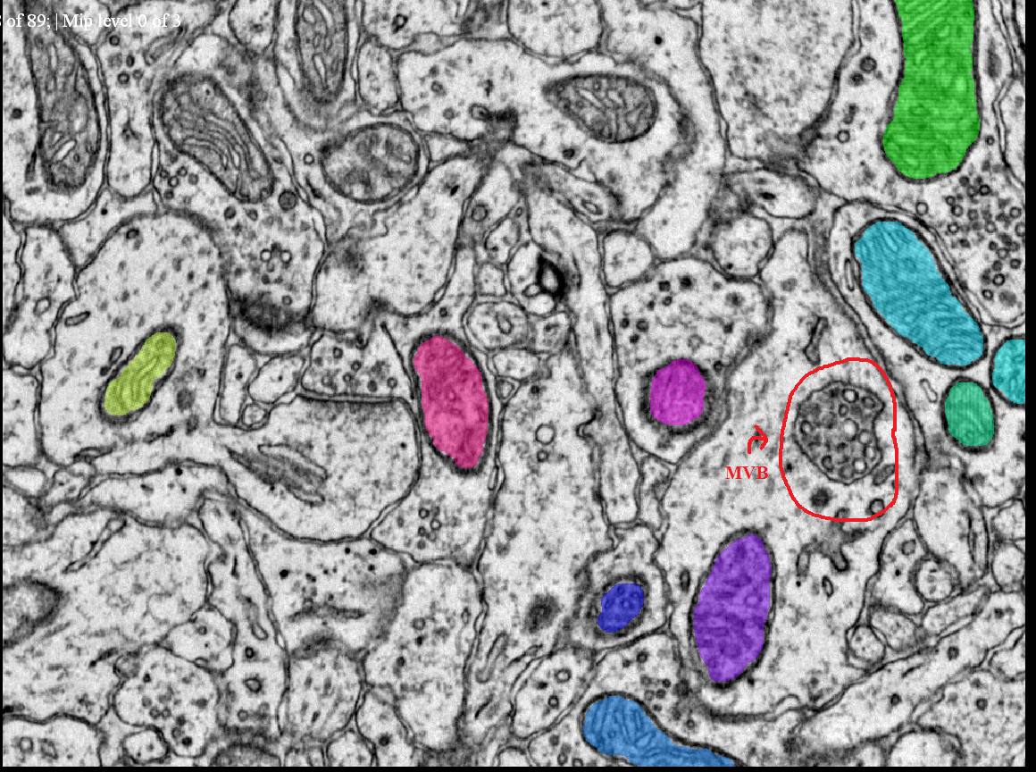
Mitochondria and an exclusive MVB

Slide 46
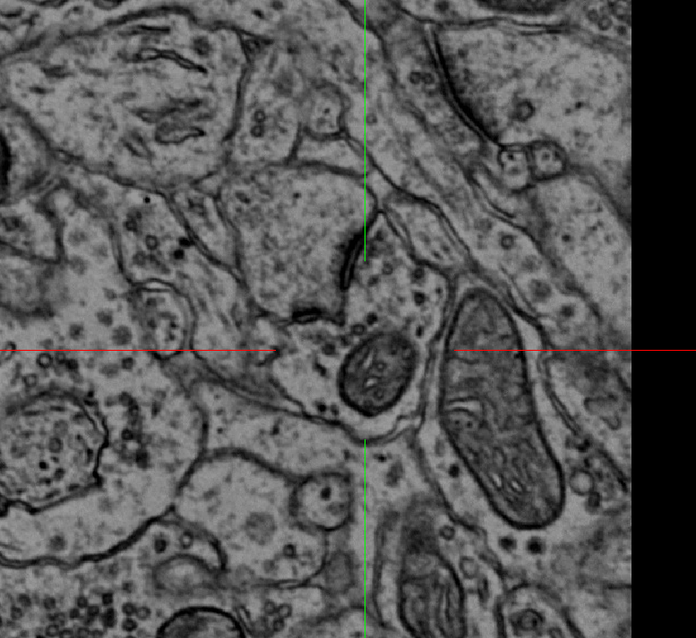
Synapse and Mitochondria

Slide 47
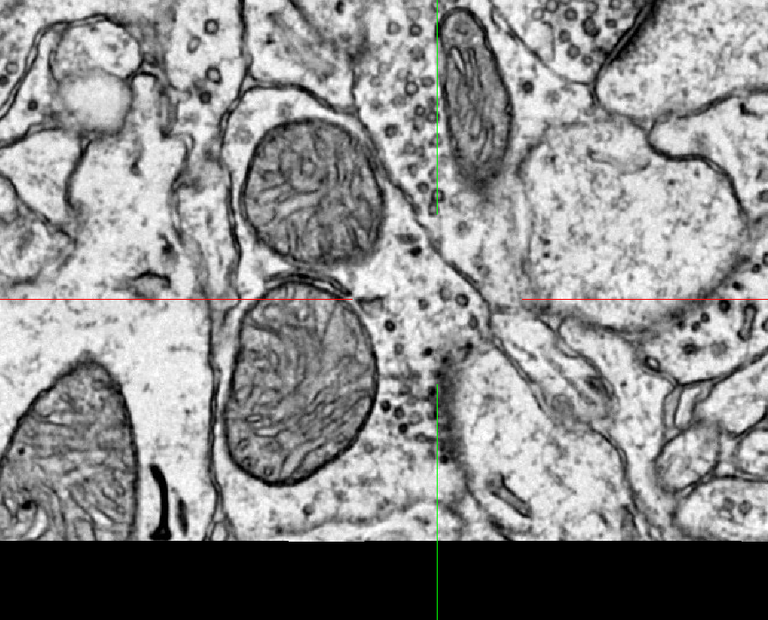
Synapse plus Mitochondria

Slide 48
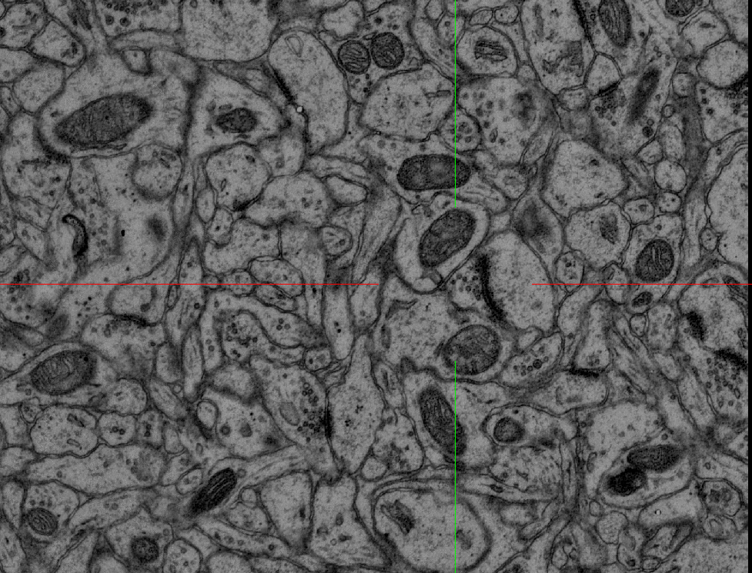
More Mitochondria

Slide 49
Mitochondria can appear in axons, glia, and dendrites
Mitochondria have been seen located around synapses

Slide 50
Vesicles
You may need spectacles to view the vesicles

Slide 51
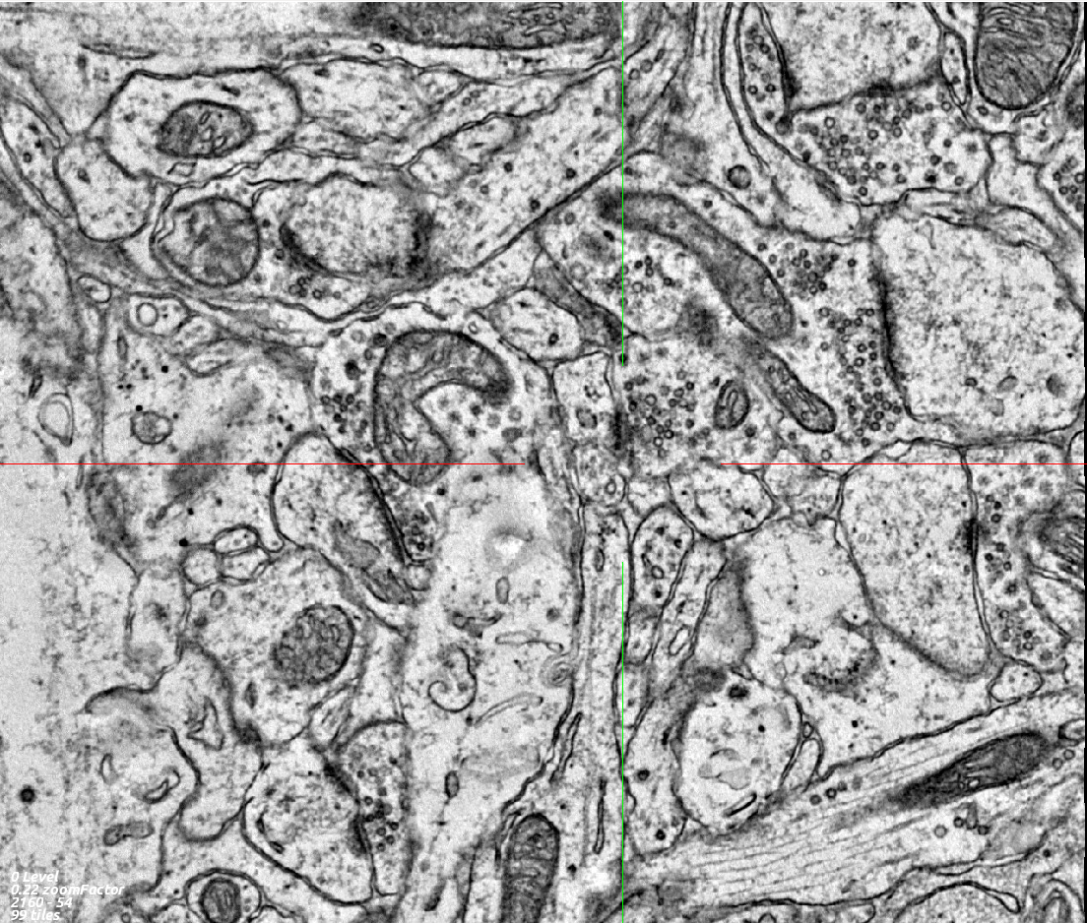
Here we have a bunch of dense vesicles. They tend to cluster around synapses.

Slide 52
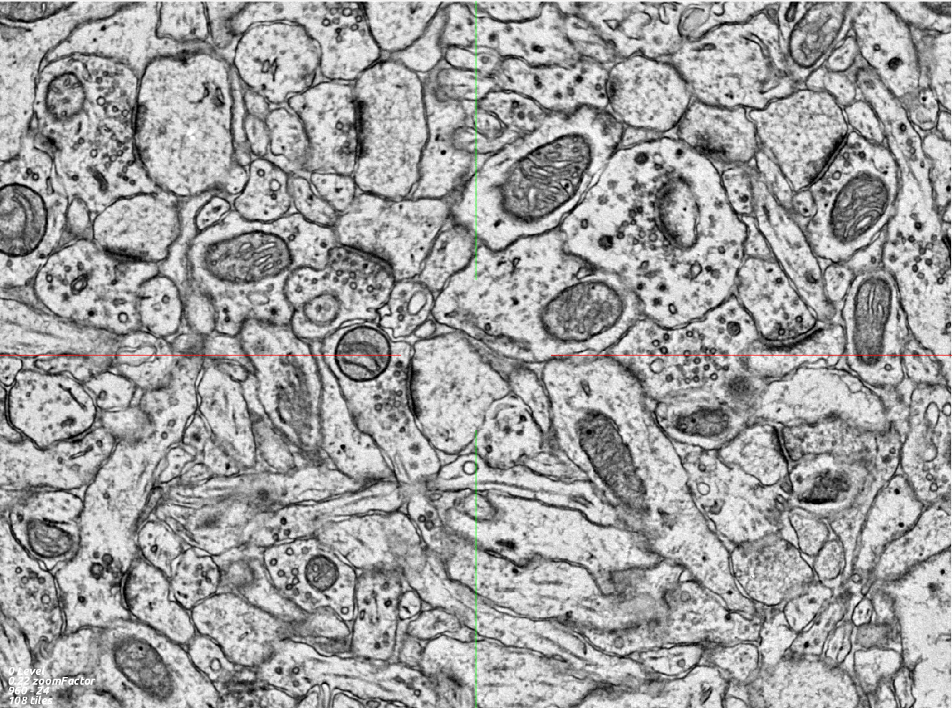
Can you spot the vesicles!?

Slide 53
You did it!

Slide 54
Vesicles are little black, gray, and white circles that send/receive neurotransmitters
Vesicles can most easily be found in dense clusters around the synapse in an axon
Vesicles can be in axons, glia, and dendrites though typically we find them most often in axons

Slide 55
Bugs and Problems
What is this? A center for bugs? It needs to be at least three times as big!

Slide 56
Slide Damage
Damage? More like unknown advantage!

Slide 57
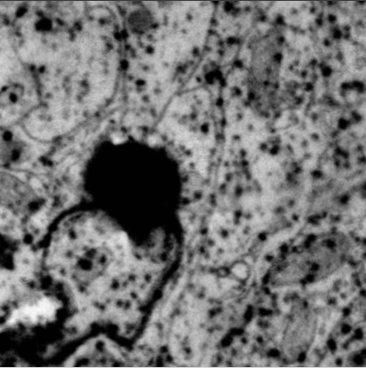
I call this kind of error, a Cheese Pizza

Slide 58
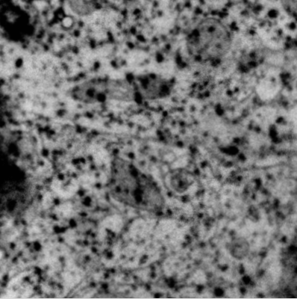
Because it looks like a Domino's Pizza!

Slide 59
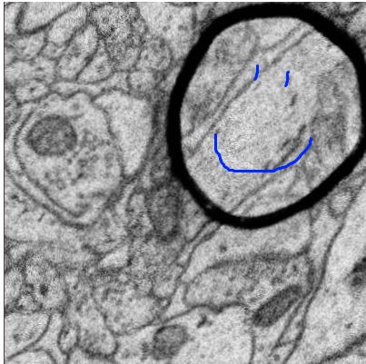
A friendly circle of damage

Slide 60
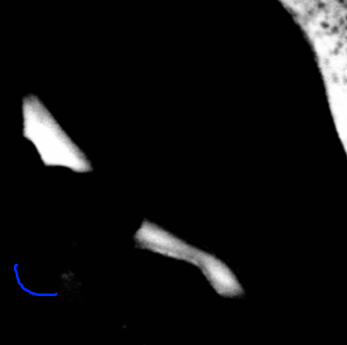
Sometimes whole slides turn to the darkside - like this one here

Slide 61
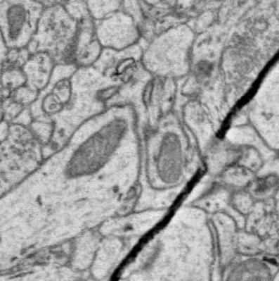

Sometimes slides will have a long dark line through them

Slide 62
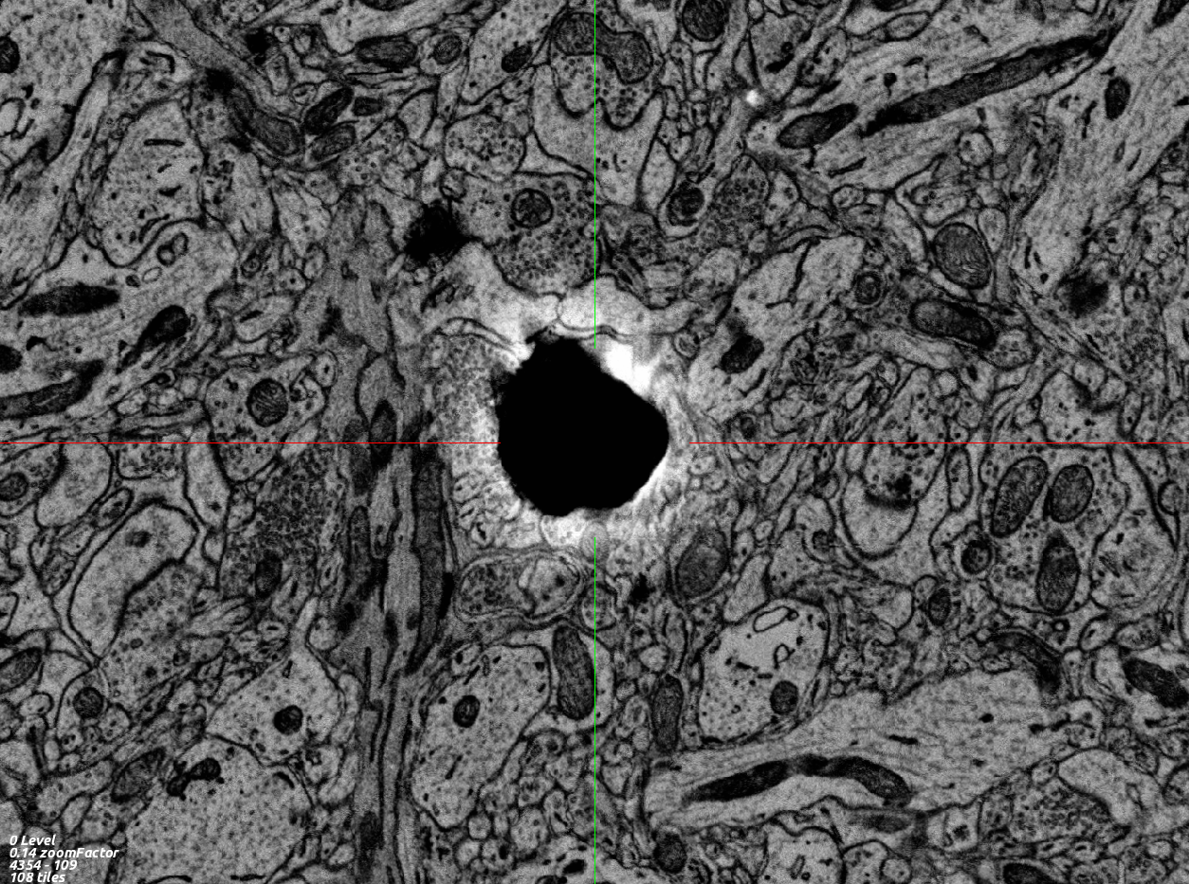

More slide damage
Pew Pew Pew
Shots fired! =D

Slide 63
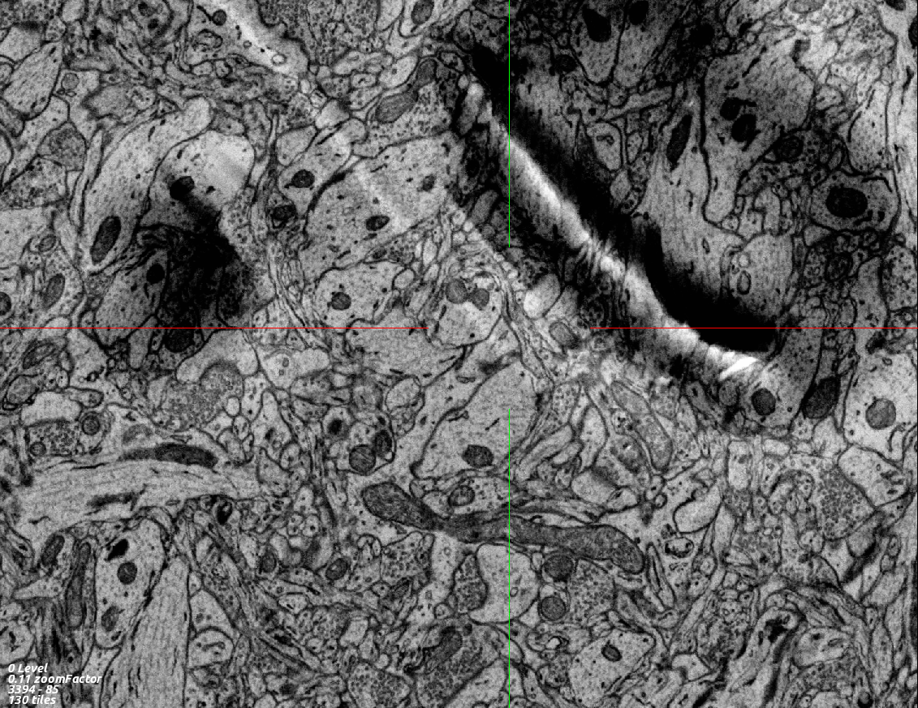
More slide damage

Slide 64


Slide 65
Rendering Issues
Ample examples

Slide 66
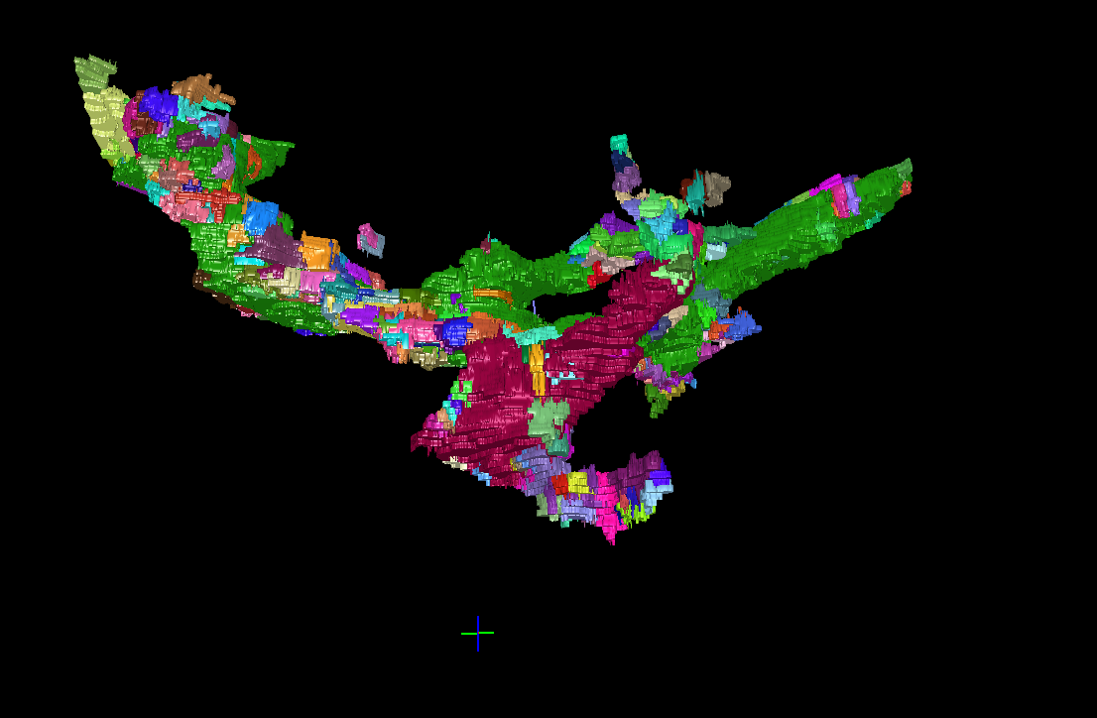
Good

Slide 67
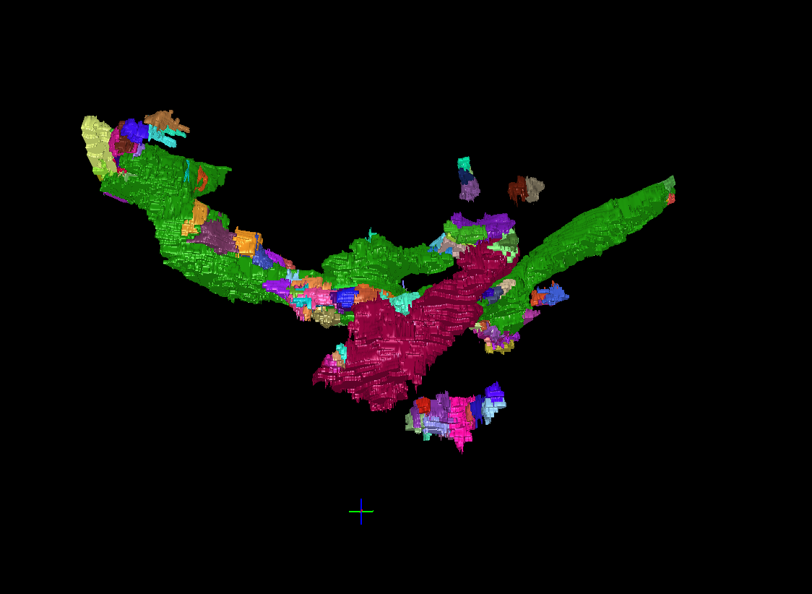
Bad

Slide 68
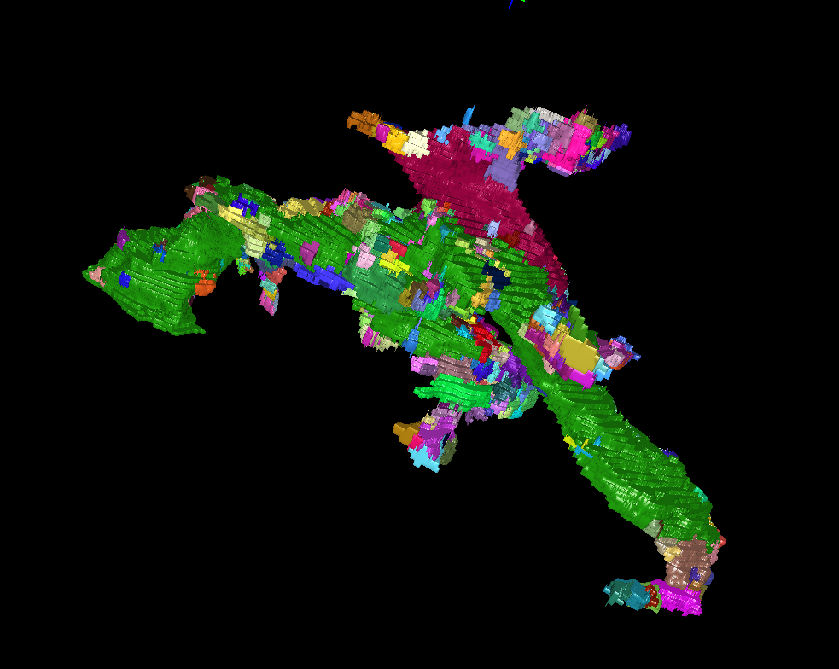
Good

Slide 69
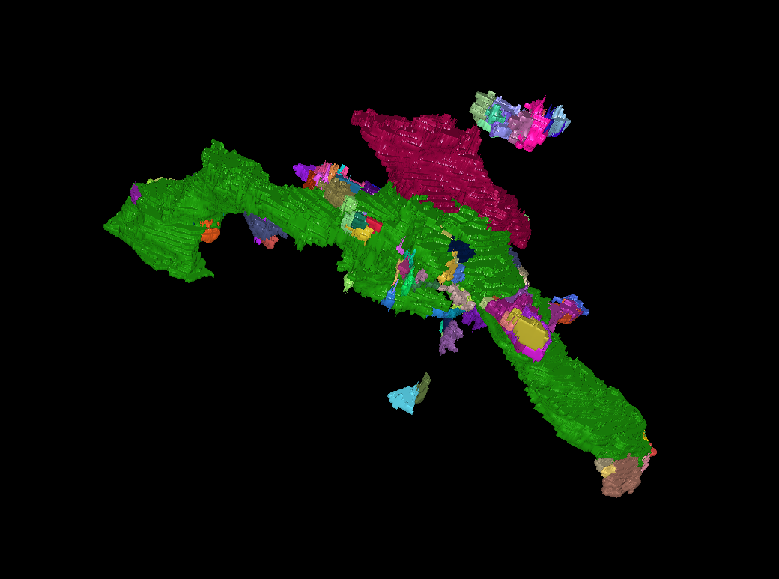
Bad

Slide 70
Good

Slide 71
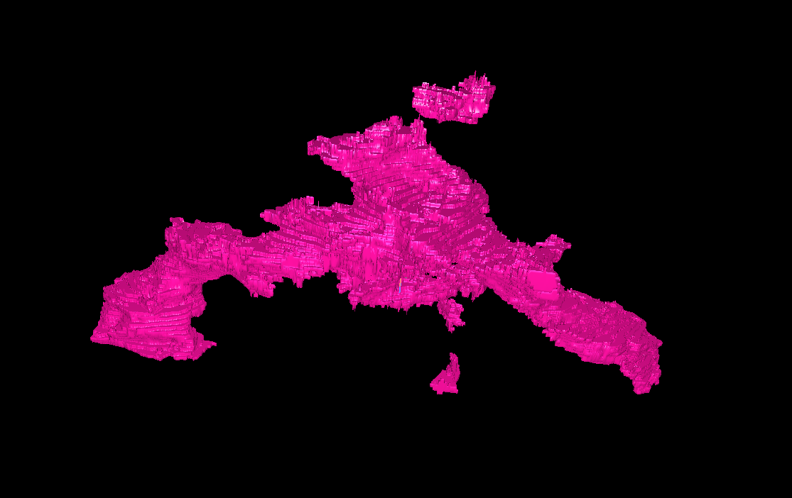
Bad

Slide 72
Are there more parallel plane or perpendicular plan axons!?
Dendrites are big and have things called spines
I do it fast. I do it slow. We do it together. Then you go.

Slide 73
Misc

Slide 74
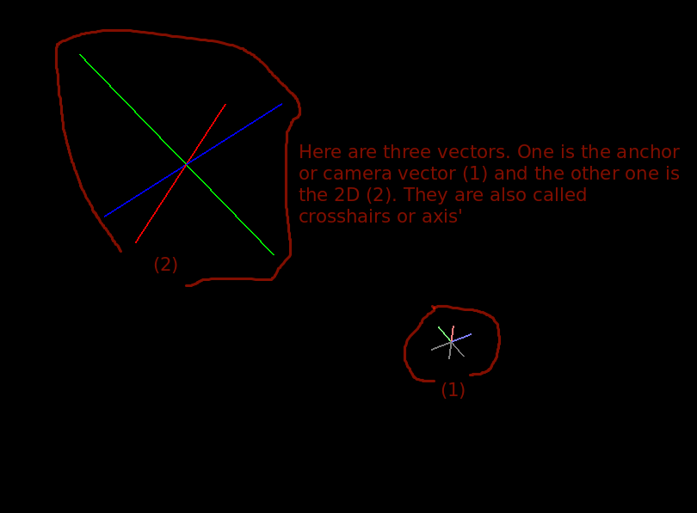
A vector is a line, three together makes an axis.

Slide 75
A weird synapse thing
Double synapse or perhaps?

Slide 76
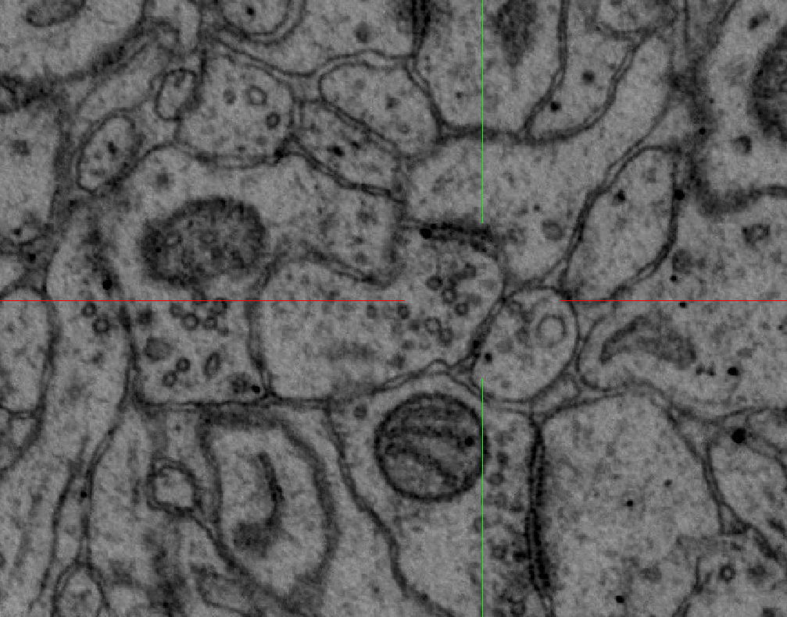

Slide 77
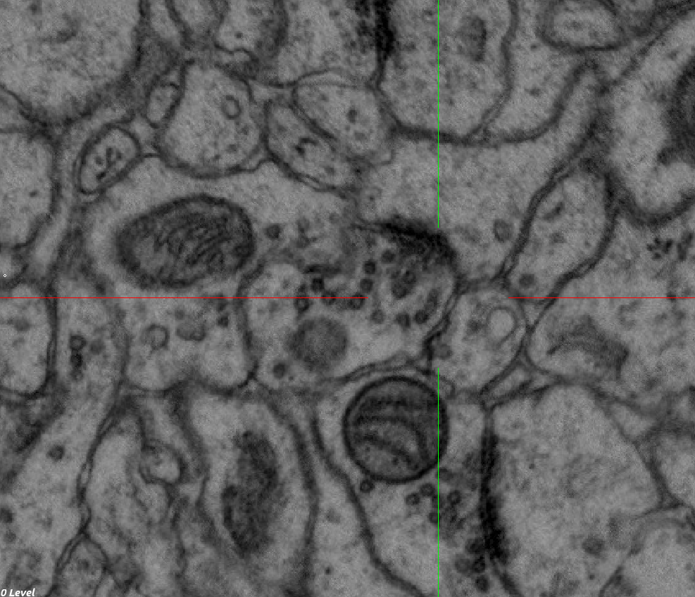

Slide 78
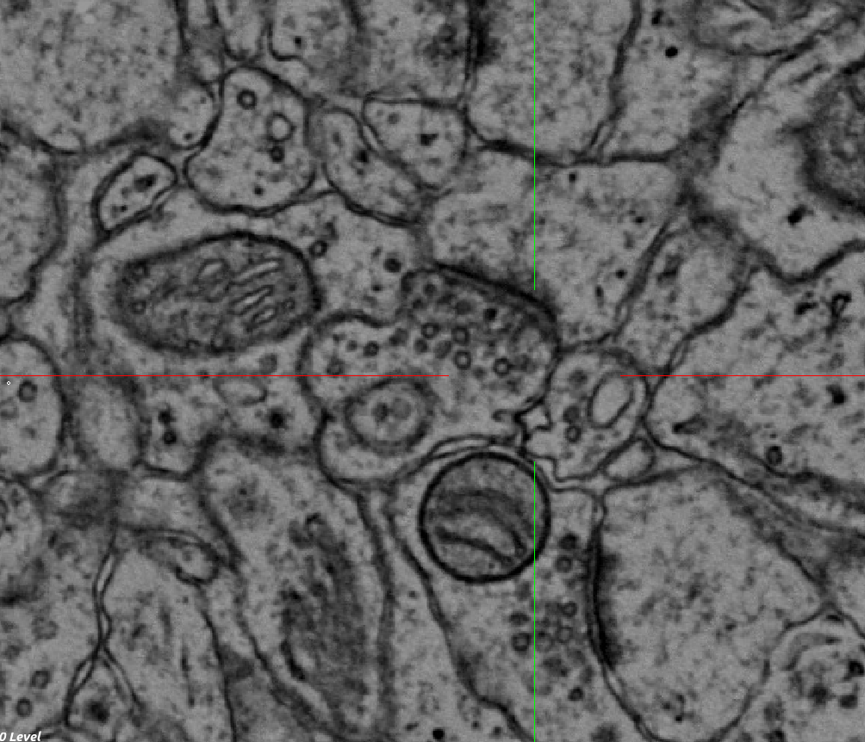

Slide 79
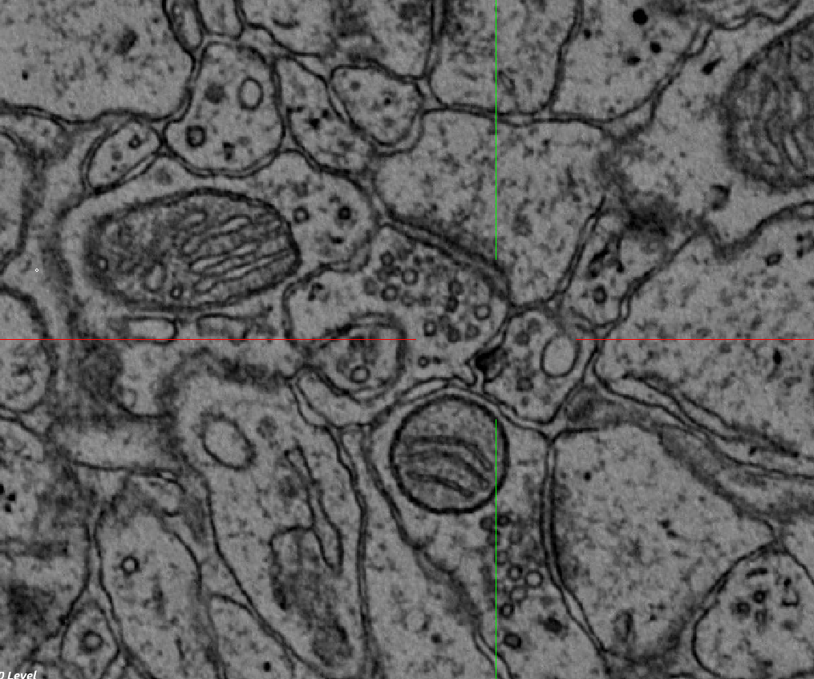

Slide 80
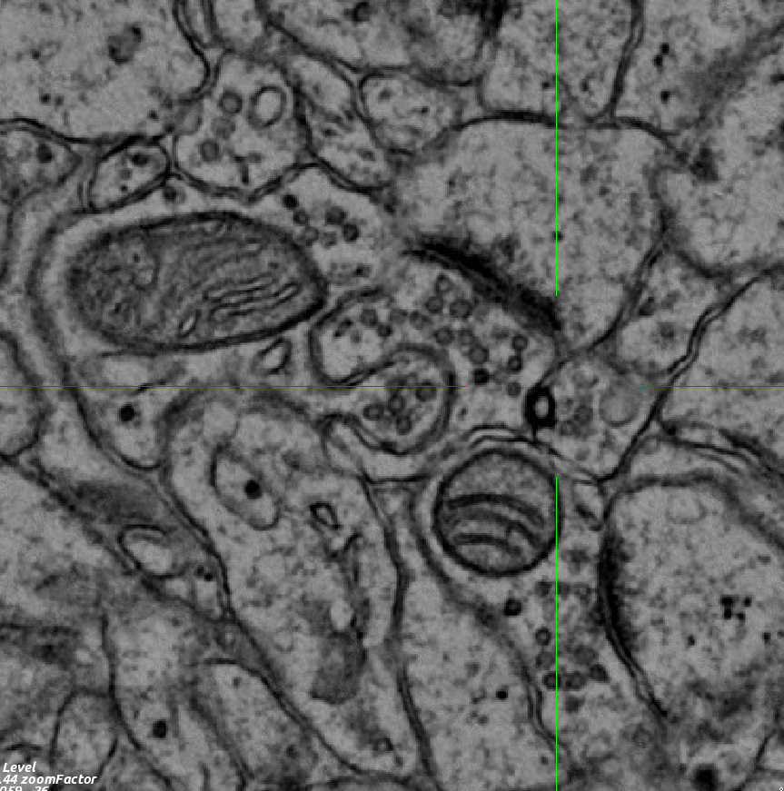

Slide 81
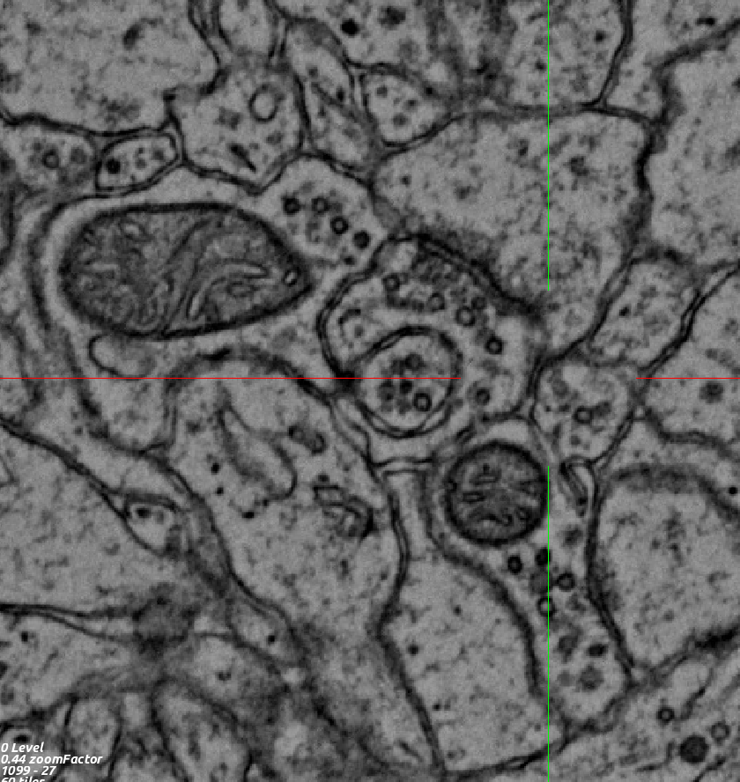

Slide 82


Slide 83


Slide 84


Slide 85


Slide 86


Slide 87


